Slide 1
CSE101-Lec#18
Multidimensional Arrays
Application of arrays

Slide 2

Outline
Defining and processing
1D array
2D array
Applications of arrays

Slide 3
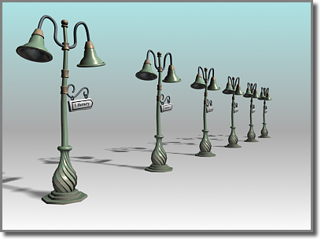
1-D array
A single- dimensional or 1-D array consists of a fixed number of elements of the same data type organized as a single linear sequence.
The elements of a single dimensional array can be accessed by using a single subscript
The arrays we have studied till now were 1D array or linear array.
Example: int a[n];

Slide 4

Program to display the average of elements in 1D array
#include<stdio.h>
void main()
{
int avg, sum=0, i;
int marks[30]; /*array declaration*/
for(i=0;i<=29;i++)
{
printf(“enter numbers”);
scanf(“%d”,&marks[i]); /*store data in array*/
}
for(i=0;i<=29;i++)
{
sum = sum + marks[i]; /*read data from an array*/
}
avg = sum/30;
printf(“Average marks= %d”, avg);
}
Quick yak:
1D arrays in daily life
Run profile of a batsman in T20
Speed of aircraft after every 10 min of flight
Notes:
To find aveage marks obtained by 30 students of a class

Slide 5
Multiple-Subscripted Arrays
Multiple subscripted arrays
Tables with rows and columns (m by n array)
Like matrices: specify row, then column
int a[rows][column];
Quick yak:
Examples on:
Movie theater sitting [13B]
Ball location – Billiards (X,Y)
Column 0 0
Column 1
Column 2
Column 3
Row 0
a[ 0 ][ 0 ]
a[ 0 ][ 1 ]
a[ 0 ][ 2 ]
a[ 0 ][ 3 ]
Row 1
a[ 1 ][ 0 ]
a[ 1 ][ 1 ]
a[ 1 ][ 2 ]
a[ 1 ][ 3 ]
Row 2
a[ 2 ][ 0 ]
a[ 2 ][ 1 ]
a[ 2 ][ 2 ]
a[ 2 ][ 3 ]
Column subscript
Array name
Row subscript

Slide 6
Multiple-Subscripted Arrays
Initialization
int a[ 2 ][ 2 ] = { { 1, 2 }, { 3, 4 } };
Initializers grouped by row in braces
If not enough, unspecified elements set to zero
Int a[ 2 ][ 2 ] = { { 1 }, { 3, 4 } };
Referencing elements
Specify row, then column
printf( "%d", a[ 0 ][ 1 ] );
1 2
3 4
1 0
3 4

Slide 7
Program to display 2D array
#include<stdio.h>
void main()
{
int a[4][3], i, j;
for(i=0; i<4; i++)
{ // for loop for rows
for(j=0; j<3;j++)
{ // for loop for columns
printf(“enter the value of a[%d][%d]: ”, i, j);
scanf(“%d”, &a[i][j]);
} //end for columns
} //end for rows
printf(“elements of 2D matrix are”);
for(i=0; i<4; i++)
{
for(j=0;j<3;j++)
{
printf(“%d\t”, a[i][j]);
} //end for
printf(“\n”);
} //end for
} //end main

Slide 8
enter the value of a[0][1] :1
enter the value of a[0][1] :2
enter the value of a[0][1] :3
enter the value of a[0][1] :4
enter the value of a[0][1] :5
enter the value of a[0][1] :6
enter the value of a[0][1] :7
enter the value of a[0][1] :8
enter the value of a[0][1] :9
Element of 2D matrix are:
2 3
5 6
7 8 9

Slide 9
Operations on arrays
Insertion of element into an array
Deletion of element from an array

Slide 10
#include <stdio.h>
#include <conio.h>
int main()
{
int array[100], position, c, n, value;
printf("Enter number of elements in array:\n");
scanf("%d", &n);
printf("Enter %d elements:\n", n);
for (c = 0; c < n; c++)
{ scanf("%d", &array[c]); }
printf("Enter the location where you wish to insert an element:\n");
scanf("%d", &position);
printf("Enter the value to insert:\n");
scanf("%d", &value);
for (c = n - 1; c >= position - 1; c--)
{ array[c+1] = array[c]; }
array[position-1] = value;
printf("Resultant array is:\n");
for (c = 0; c <= n; c++)
{ printf("%d\n", array[c]); }
}
Program to insert an element into an array

Slide 11
Enter number of elements in array: 4
Enter 4 elements
2
45
66
33
Enter the location where you wish to insert an element : 2
Enter the value to insert : 99
Resultant array is :
2
99
45
66
33

Slide 12
#include <stdio.h>
int main()
{
int array[100], position, c, n;
printf("Enter number of elements in array\n");
scanf("%d", &n);
printf("Enter %d elements\n", n);
for (c = 0; c < n; c++)
{ scanf("%d", &array[c]); }
printf("Enter the location where you wish to delete from an array\n");
scanf("%d", &position);
for (c = position-1; c < n; c++)
{ array[c] = array[c+1]; }
printf("Resultant array is\n");
for (c = 0; c < n-1; c++)
{ printf("%d\n", array[c]); }
}
Program to delete an element from an array

Slide 13
Enter number of elements in array: 4
Enter 4 elements
2
45
66
33
Enter the location where you wish to to delete from an array : 2
Resultant array is :
2
66
33

Slide 14
Application Of Array :
Stores Elements of Same Data Type
Array is used to store the number of elements that are of same data type.
Eg: int students[30];
array of marks of five subjects for single student.
float marks[5];
array of marks of five subjects for 30 students.
float marks[30][5]
Similarly if we declare the character array then it can hold only character.
So in short character array can store character variables while floating array stores only floating numbers.

Slide 15
Array Used for Maintaining multiple variable names using single name
Suppose we need to store 5 roll numbers of students then without declaration of array we need to declare following -
int roll1,roll2,roll3,roll4,roll5;
Now in order to get roll number of first student we need to access roll1.
Guess if we need to store roll numbers of 100 students then what will be the procedure.
Maintaining all the variables and remembering all these things is very difficult.
So we are using array which can store multiple values and we have to remember just single variable name.

Slide 16
Array Can be Used for Sorting Elements
We can store elements to be sorted in an array and then by using different sorting technique we can sort the elements.
Different Sorting Techniques are :
1. Bubble Sort
2. Insertion Sort
3. Selection Sort
Notes:
To sort the elements without using array we have to compare each and every variable individually without using loops.

Slide 17
Array Can Perform Matrix Operation
Matrix operations can be performed using the array. We can use 2-D array
To store the matrix.
To perform all mathematical manipulations on matrix.
Matrix can be multi-dimensional.

Slide 18
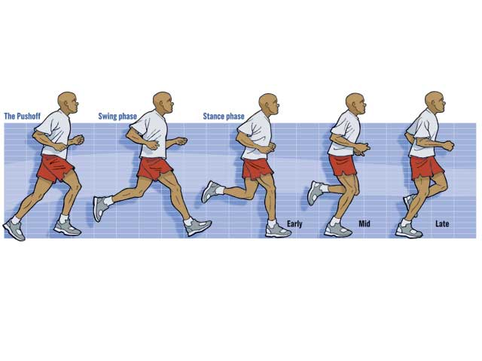


Some classic daily examples…
1D
Running
Distance [D]
2D
Long Jump
Distance, Height [D,H]
3D
High Jump
Distance, Height, Roll [D,H,R]

Slide 19

Next Lecture
Finding my stuffs from a mess …??
Searching Technique

